Slide 1
Capstone Project 2 Retail Sales Prediction By Akash raj Data Science Trainee, AlmaBetter Email:-akashraj31123@gmail.com

Slide 2
Approach The following approach was followed in the completion of the project :
* Data Collection and Preprocessing
- Importing important libraries and modules - Data Cleaning - Missing Data Handling - Merging the Datasets
* Exploratory Data Analysis
- Categorical Features - Numerical Features - EDA Conclusion
* Feature Selection and Outlier Detection
- Feature Engineering - Outlier Detection and Treatment

Slide 3
* Modeling
- Train Test Split
-Linear
-Polynomial
-Lasso
-Ridge
-Baseline Model
-Decision Tree
-Feature Importance
Problem Statement :
Rossmann operates over 3,000 drug stores in 7 European countries. Currently, Rossmann store managers are tasked with predicting their daily sales for up to six weeks in advance. Store sales are influenced by many factors, including promotions, competition, school and state holidays, seasonality, and locality. With thousands of individual managers predicting sales based on their unique circumstances, the accuracy of results can be quite varied. You are provided with historical sales data for 1,115 Rossmann stores. The task is to forecast the "Sales" column for the test set. Note that some stores in the dataset were temporarily closed for refurbishment

Slide 4
Retail Sales Prediction :
Sales forecasting refers to the process of estimating demand for or sales of a particular product over a specific period of time. Businesses use sales forecasts to determine what revenue they will be generating in a particular timespan to empower themselves with powerful and strategic business plans. Important decisions such as budgets, hiring, incentives, goals, acquisitions and various other growth plans are affected by the revenue the company is going to make in the coming months and for these plans to be as effective as they are planned to be it is important for these forecasts to also be as good. The work here predicts the sales for a drug store chain in the European market for a time period of six weeks and compares the results of different machine learning algorithms

Slide 5
Data Summary
● Id - an Id that represents a (Store, Date) duple within the set
● Store - a unique Id for each store
● Sales - the turnover for any given day (Dependent Variable)
● Customers - the number of customers on a given day
● Open - an indicator for whether the store was open: 0 = closed, 1 = open
● StateHoliday - indicates a state holiday. Normally all stores, with few exceptions, are closed on state holidays. Note that all schools are closed on public holidays and weekends. a = public holiday, b = Easter holiday, c = Christmas, 0 = None
● SchoolHoliday - indicates if the (Store, Date) was affected by the closure of public schools
● StoreType - differentiates between 4 different store models: a, b, c, d

Slide 6
● Assortment - describes an assortment level: a = basic, b = extra, c = extended. An assortment strategy in retailing involves the number and type of products that stores display for purchase by consumers.
● CompetitionDistance - distance in meters to the nearest competitor store
● CompetitionOpenSince[Month/Year] - gives the approximate year and month of the time the nearest competitor was opened
● Promo - indicates whether a store is running a promo on that day
● Promo2 - Promo2 is a continuing and consecutive promotion for some stores: 0 = store is not participating, 1 = store is participating
● Promo2Since[Year/Week] - describes the year and calendar week when the store started participating in Promo2
● PromoInterval - describes the consecutive intervals Promo2 is started, naming the months the promotion is started anew. E.g. "Feb,May,Aug,Nov" means each round starts in February, May, August, November of any given year for that store

Slide 7
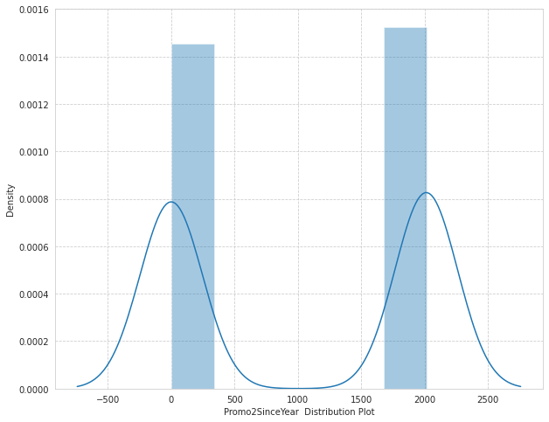
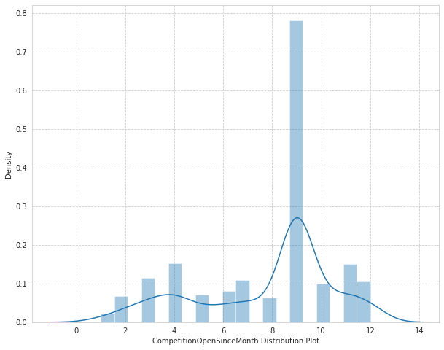
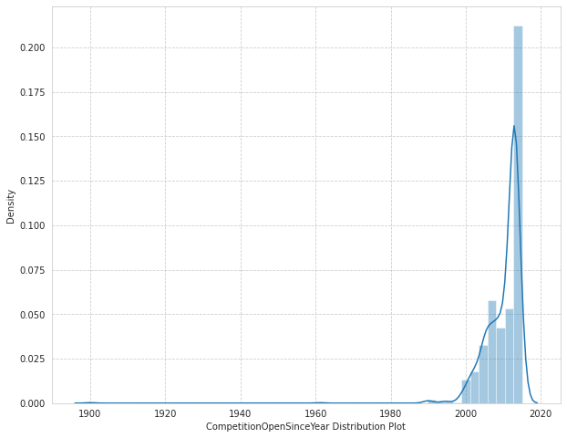
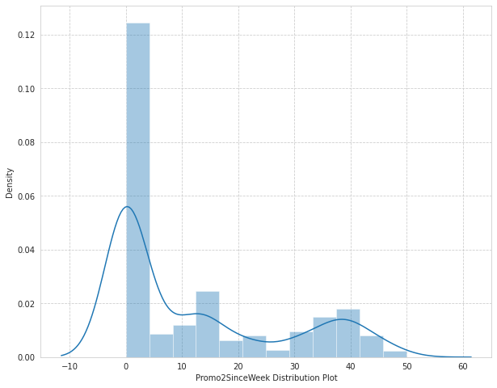
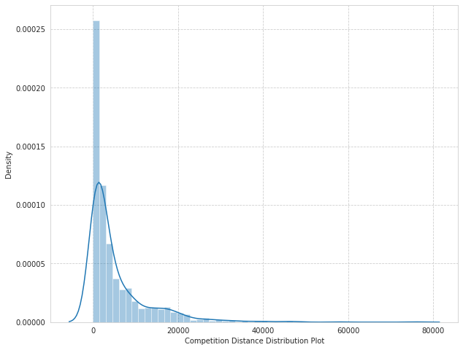
Exploratory Data Analysis
Distribution plot of all null values :

Slide 8
The dataset had a lot of nulls in the following columns:
** Out of 1115 entries there are missing values for the columns:**
** CompetitionDistance- distance in meters to the nearest competitor store, the distribution plot would give us an idea about the distances at which generally the stores are opened and we would impute the values accordingly
** CompetitionOpenSinceMonth- gives the approximate month of the time the nearest competitor was opened, mode of the column would tell us the most occuring month
** CompetitionOpenSinceYear- gives the approximate year of the time the nearest competitor was opened, mode of the column would tell us the most occuring month
** Promo2SinceWeek, Promo2SinceYear and PromoInterval are NaN wherever Promo2 is 0 or False as can be seen in the first look of the dataset. They can be replaced with 0.

Slide 9
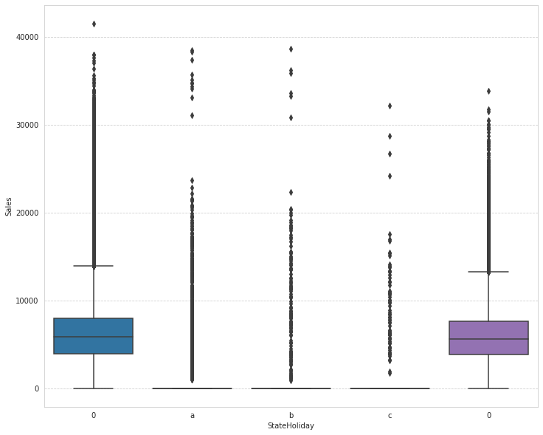
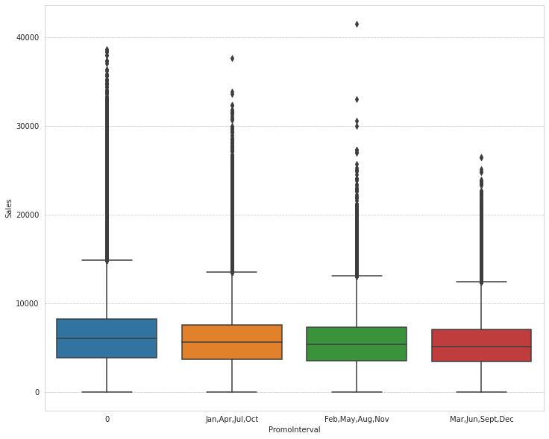
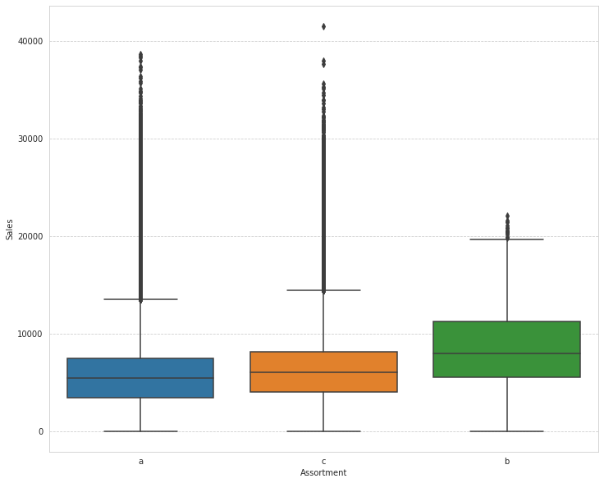
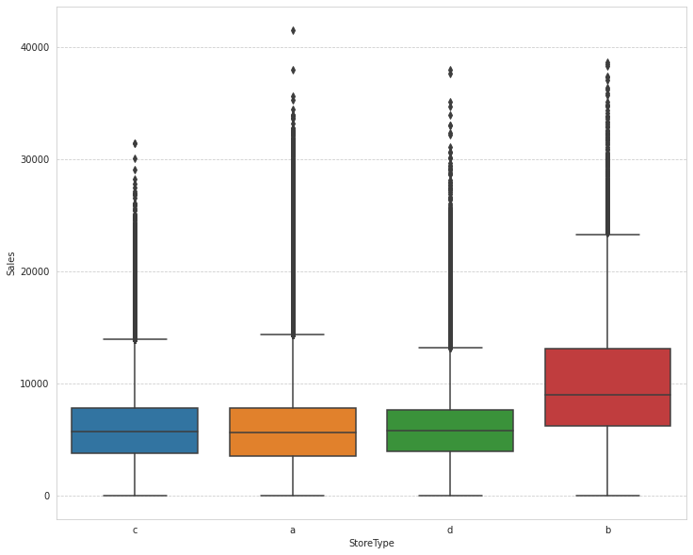
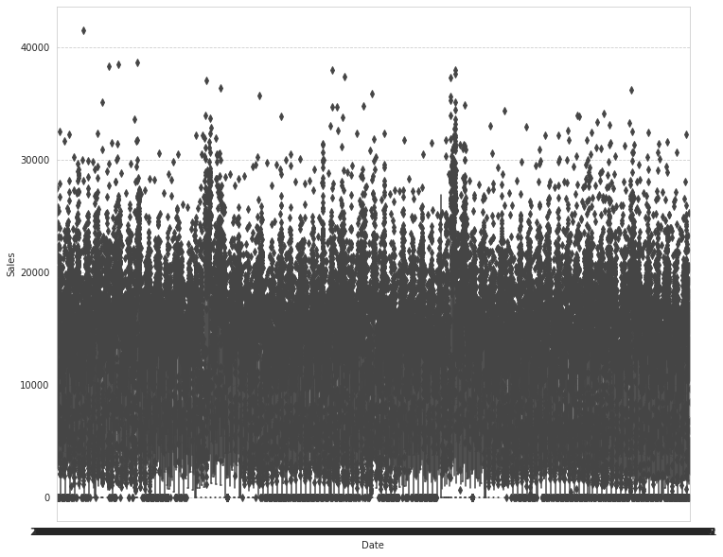
Categorical Insights:
ploting Box plot to visualize and trying to get information from plot

Slide 10
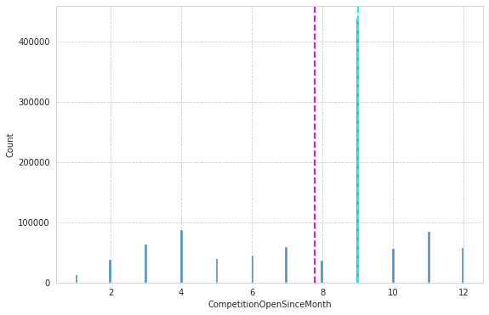
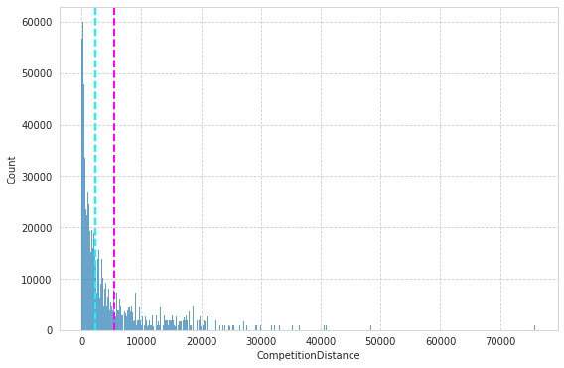
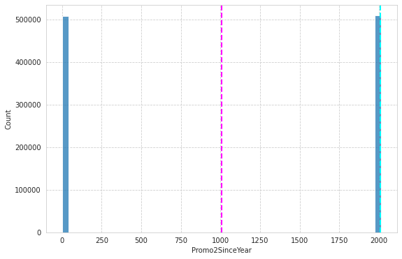
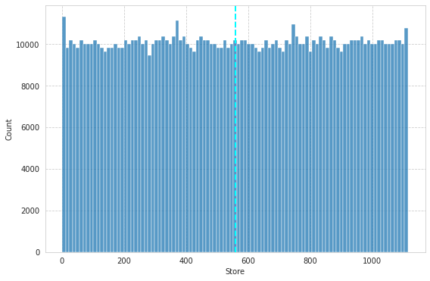
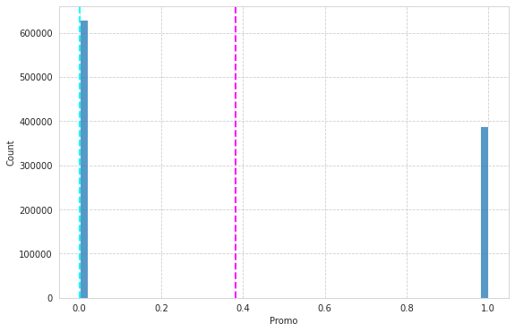
# Plotting histogram of dataset of numerical variables:

Slide 11
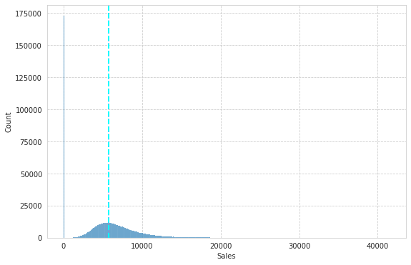
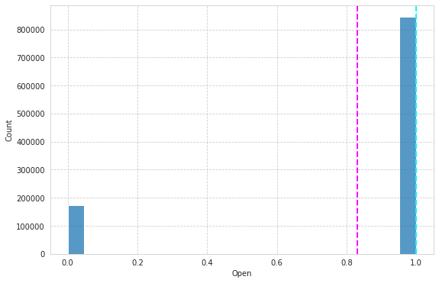
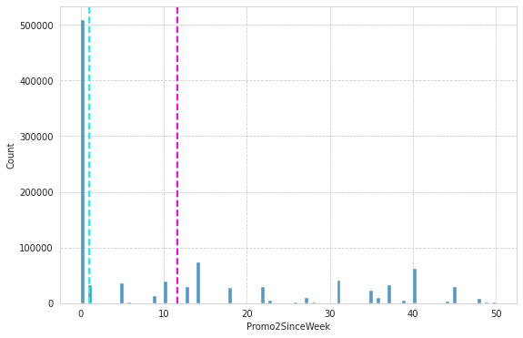
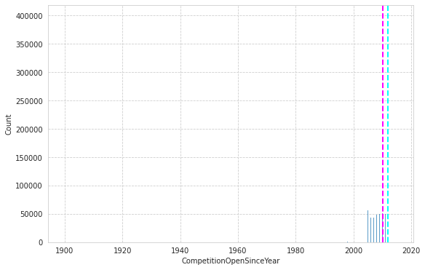

Slide 12
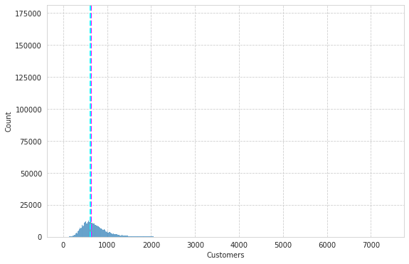
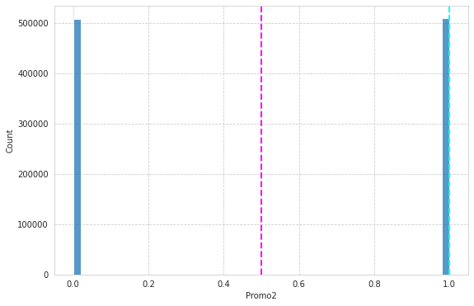
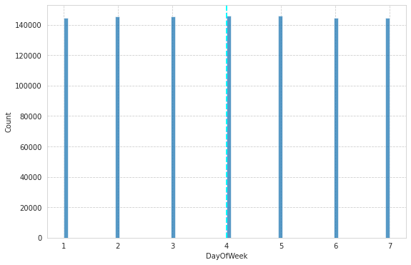
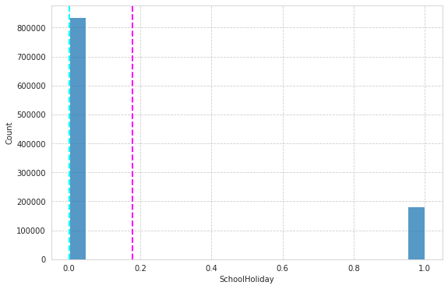

Slide 13
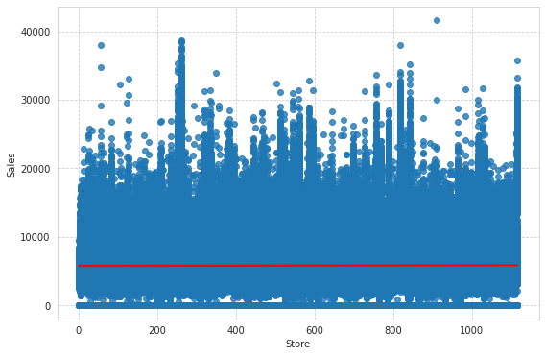
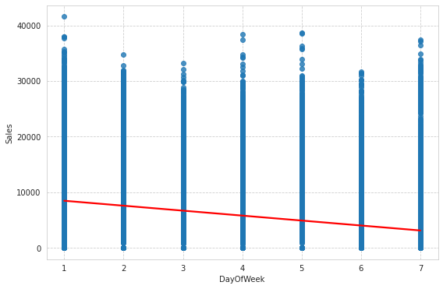
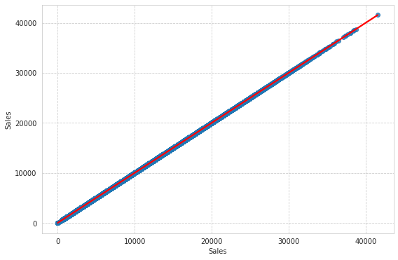
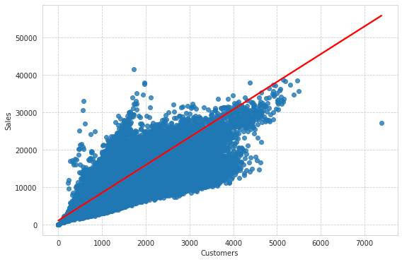
Plotting Regression plot of each columns of dataset v/s sales count columns

Slide 14
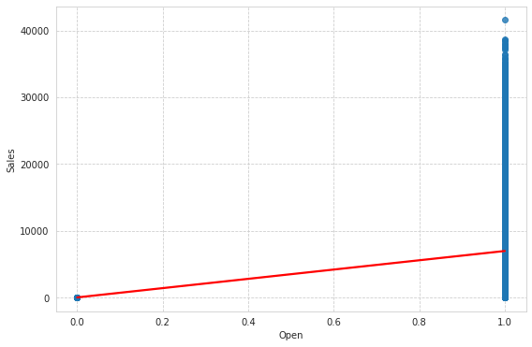
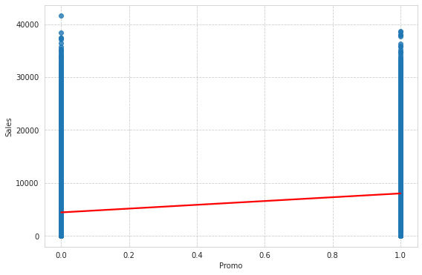
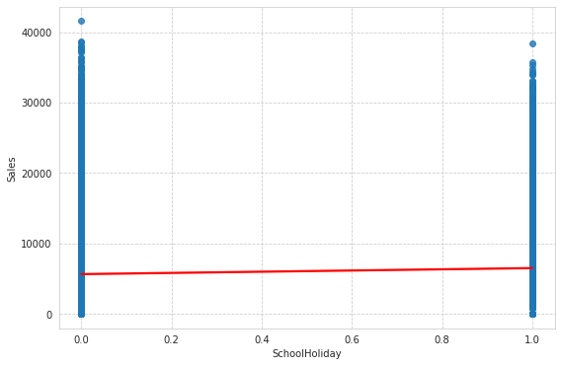
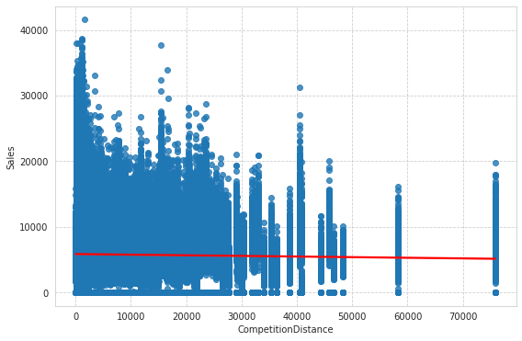

Slide 15
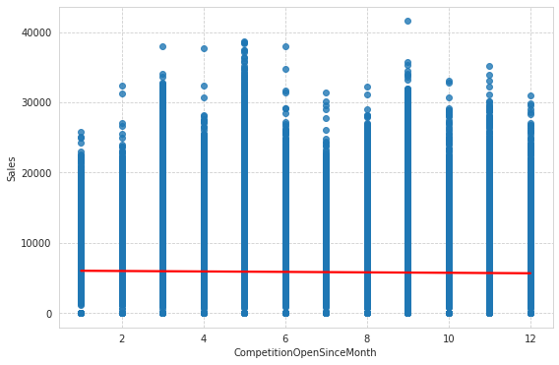
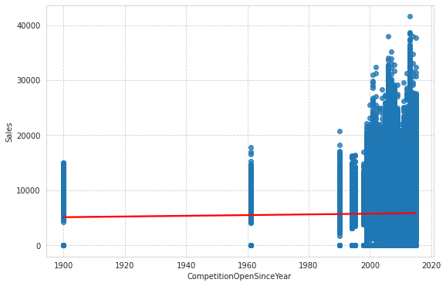
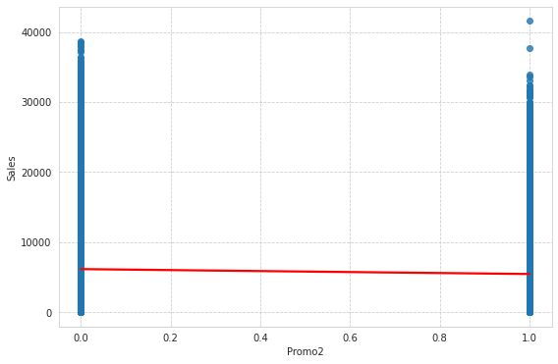
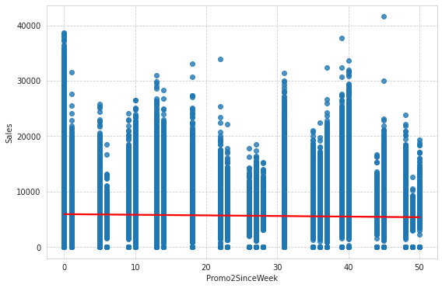
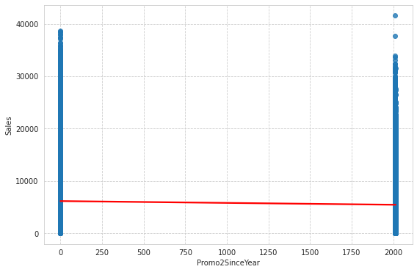

Slide 16
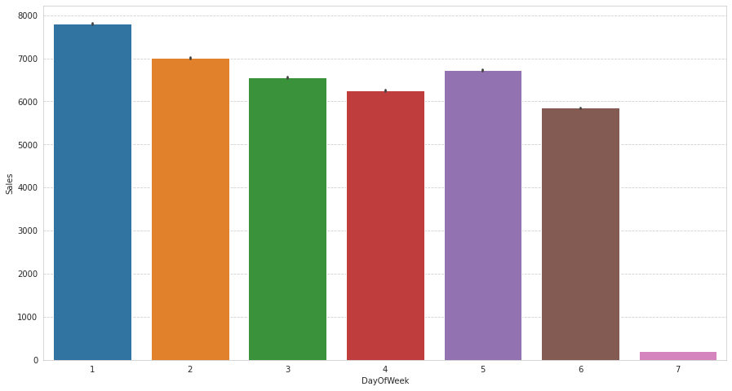
Barplots visualization of each columns of dataset v/s Sales count columns:
Here it can be deduced that there were more sales on Monday, probably because shops generally remain closed on Sundays which had the lowest sales in a week. This validates the hypothesis about this feature.

Slide 17
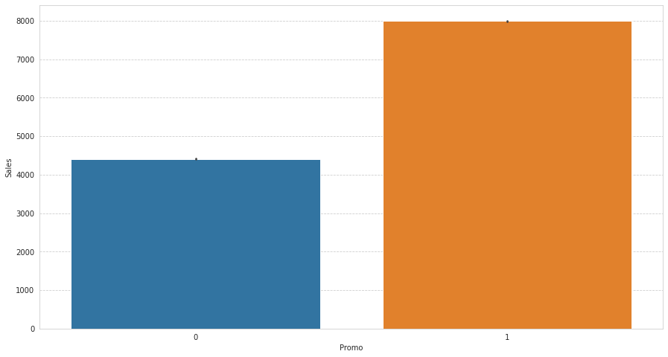
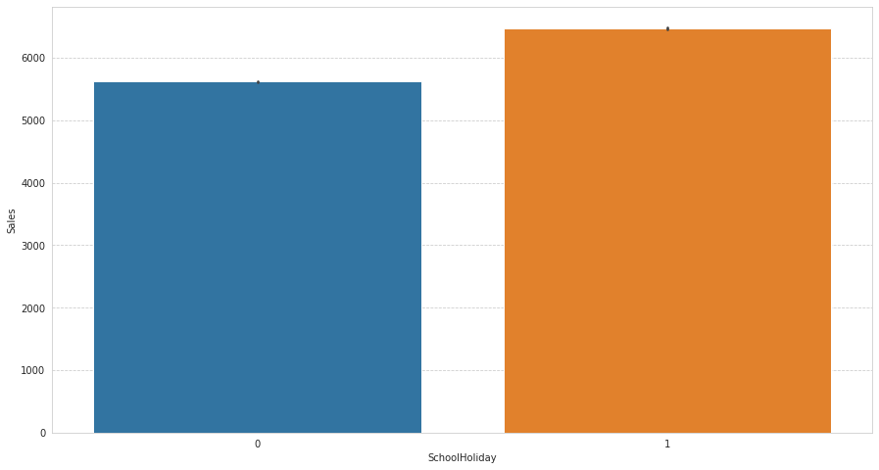
Promotion has a positive effect on Sales indicating high sales for stores with Promo=1
Sales were high on an average on School Holidays indicating School Holidays weren’t compulsory by the law and comparatively more sales were recorded on holidays.

Slide 18
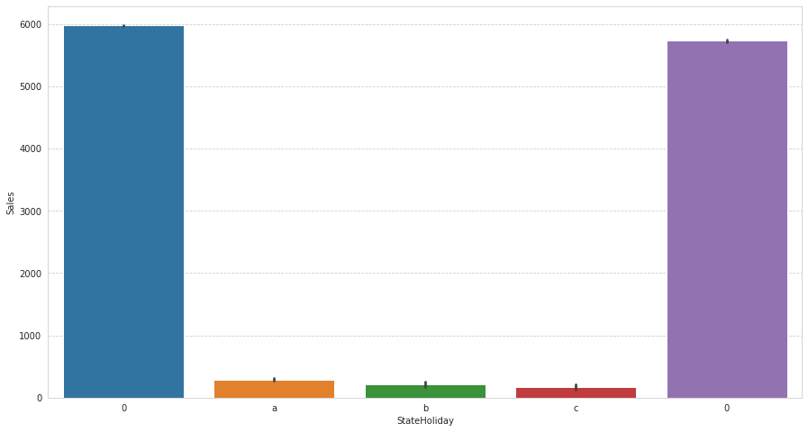
Sales were low whenever there was a State Holiday indicating only a few stores were open on these days. Normally all stores, with few exceptions, are closed on state holidays. Note that all schools are closed on public holidays and weekends. a = public holiday, b = Easter holiday, c = Christmas, 0 = None. Lowest of Sales were seen on state holidays especially on Christmas.

Slide 19
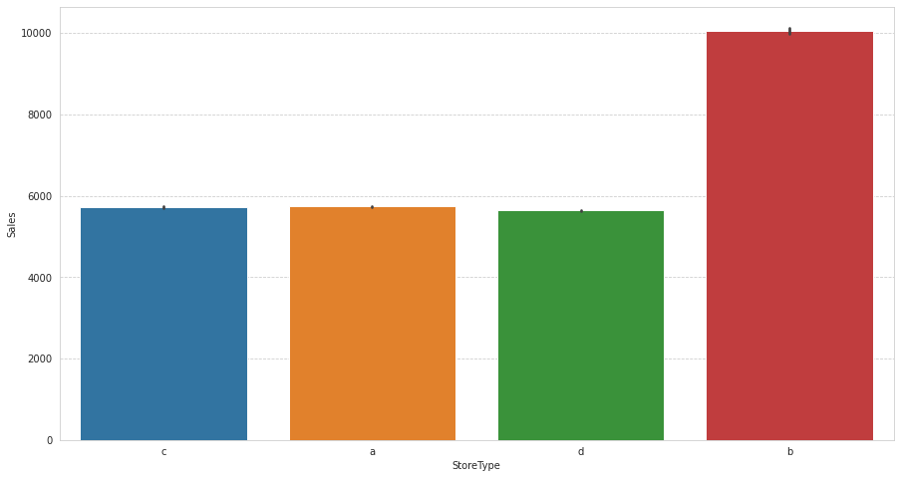
A bar plot represents an estimate of central tendency for a numeric variable with the height of each rectangle. The store type b has the highest sales on an average.

Slide 20
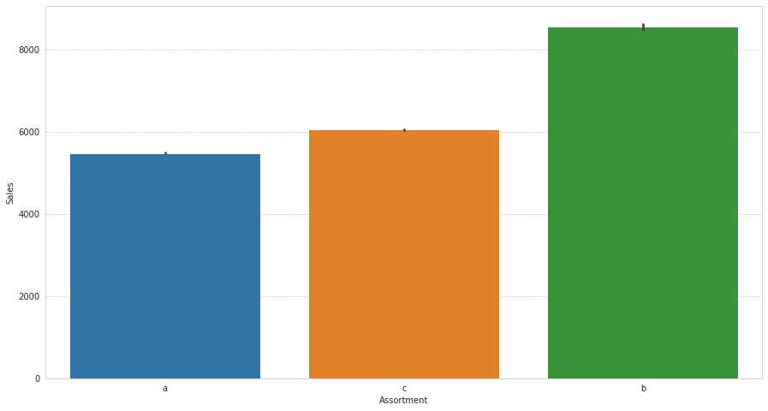
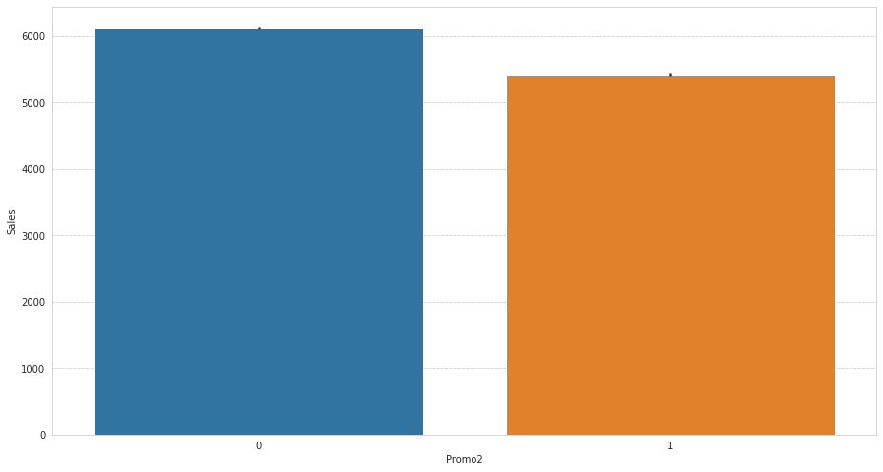
Assortment type b has the highest sales on an average
With Promo2, slightly more sales were seen without it which indicates there are many stores not participating in promo.

Slide 21
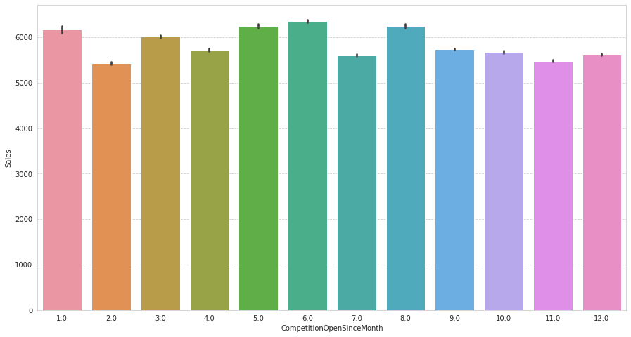
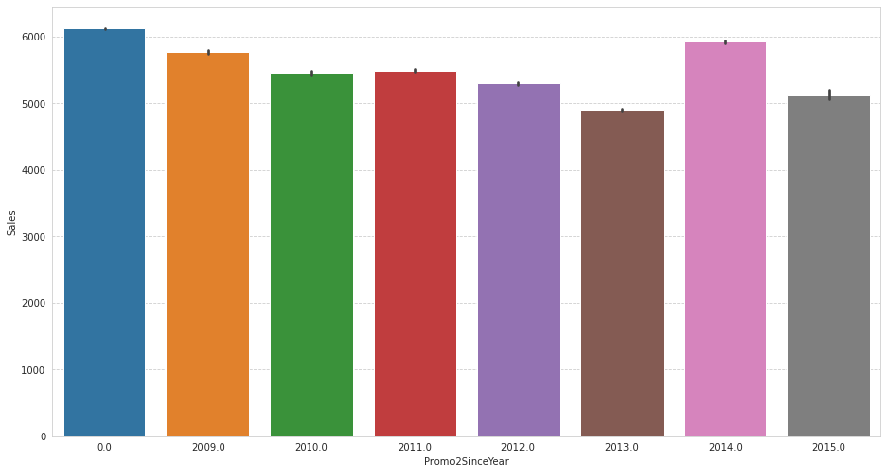

Slide 22
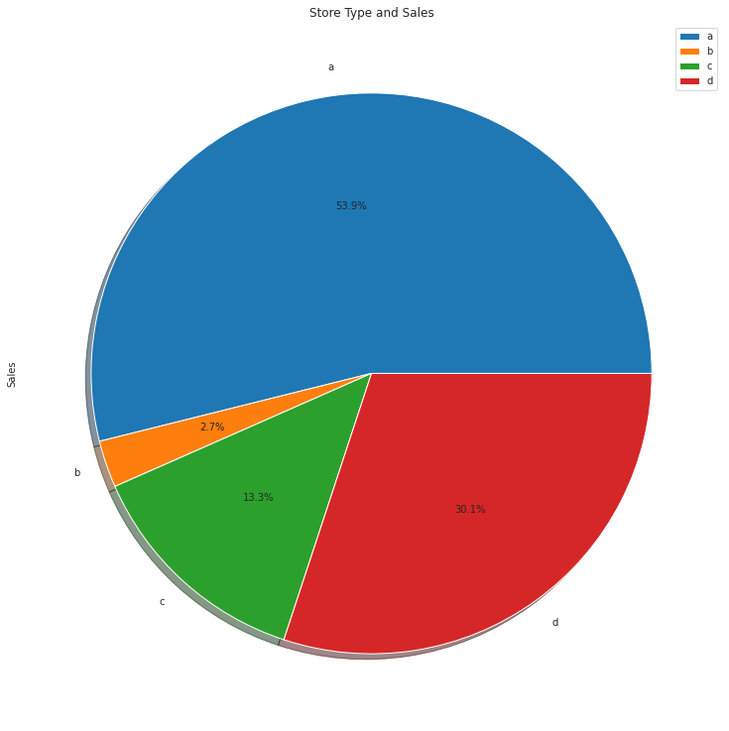
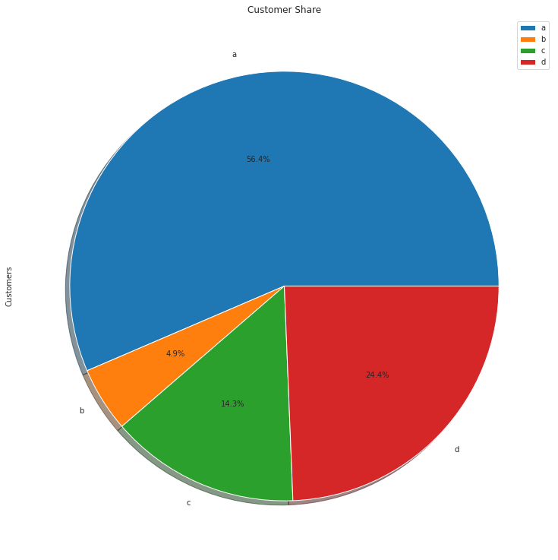
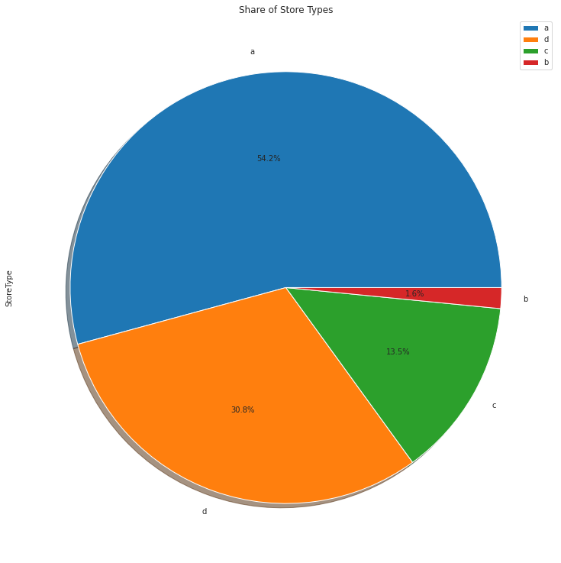

Slide 23
Observation:
* A bar plot represents an estimate of central tendency for a numeric variable with the height of each rectangle. Earlier it was seen that the store type b had the highest sales on an average because the default estimation function to the barplot is mean.
* But upon further exploration it can be clearly observed that the highest sales belonged to the store type a due to the high number of type a stores in our dataset. Store type a and c had a similar kind of sales and customer share.
* Interesting insight to note is that store type b with highest average sales and per store revenue generation looks healthy and a reason for that would be all three kinds of assortment strategies involved which was seen earlier.

Slide 24
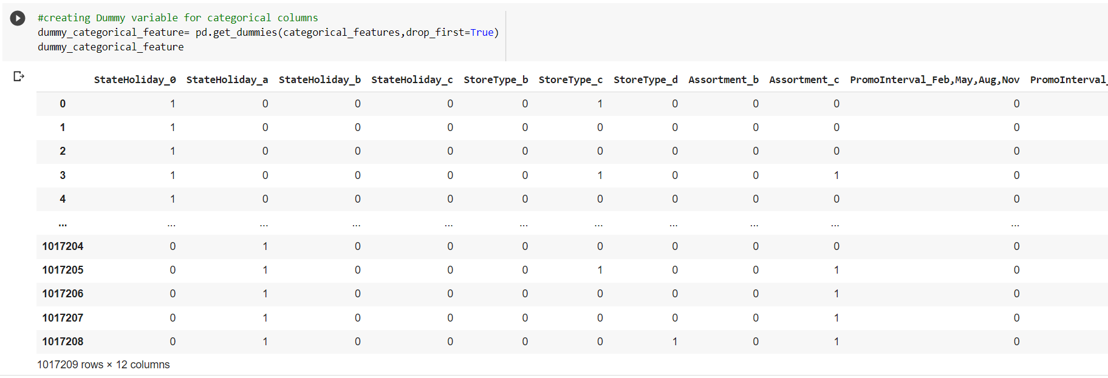
Feature engineering :
One hot encoding:

Slide 25
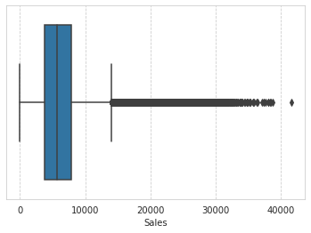

Ways to Detect and Remove the Outliers:

Slide 26

Correlation:

Slide 27


Calculate VIF and remove drop columns VIF greater than 5
Drop columns

Slide 28


Modeling:
Linear Regression :

Slide 29


Polynomial Regression

Slide 30


Regularization
Lasso Regression

Slide 31


Ridge Regression

Slide 32


Decision Tree

Slide 33

Features importance of decision tree

Slide 34


Evaluation Metrics of all models

Slide 35
Final Conclusion:
It is quite evident from the results that polynomial and Desission Tree is the best model that can be used for the Rossmann Sales Prediction since the performance metrics (mse,rmse) shows lower and (r2,adjusted_r2) show a higher value for the polynomial and Desission Tree

Slide 36
References:
● Java point
● GeeksforGeeks
● Analytics Vidhya Blogs
● Towards Data Science Blogs
● W3school
● Scikit-Learn Org
Thanks

